Slide 1
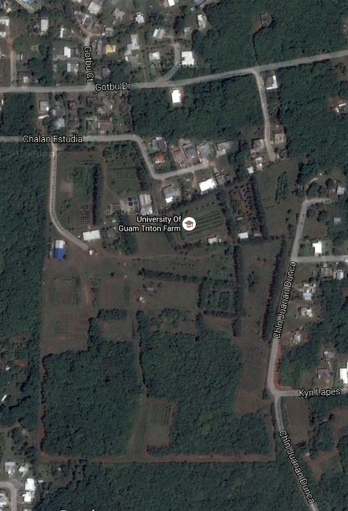
Not sure if lost numbers are 100% correct- could find out by checking notebook
148.820 Faint signal in woods
148.782
Under trailer
148.132
Weak signal over fence in
Neighbors’ dense woods
Kat

